Slide 1
OTC Collateral Management
Dirk Daveluy – Head of Clearing & Collateral
RWE Supply & Trading – Back Office

Slide 2



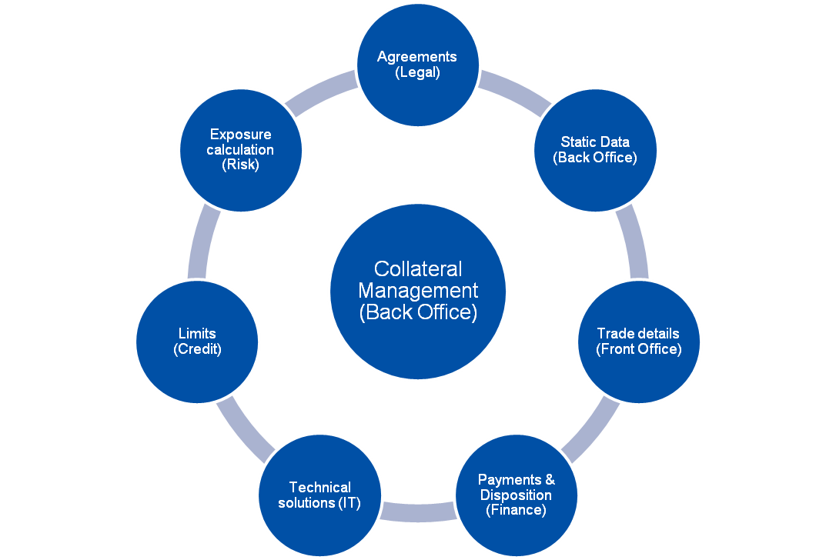










Slide 3
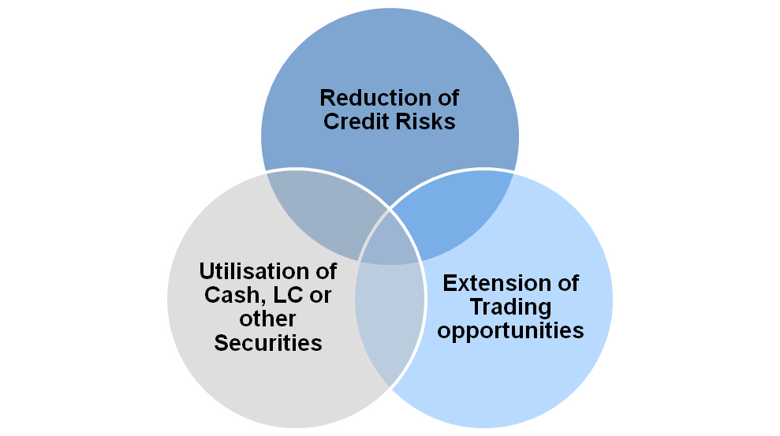
Collateral Management Goals
Collateral will not turn a poor credit risk into a good credit and it never eliminate credit risk. It just improves your rate of recovery
“mastering collateral management and documentation”
Paul C. Harding & Christian A. Johnson – FT Prentice Hall / market editions
Exposure covers Marked to Market (MTM) and Settlement Exposure (SE)
Collateralisation starts with the conclusion of a Credit Support Annex to a Master Agreement (ISDA, EFET,NBP,IETA, CPMA, etc…)

Slide 4
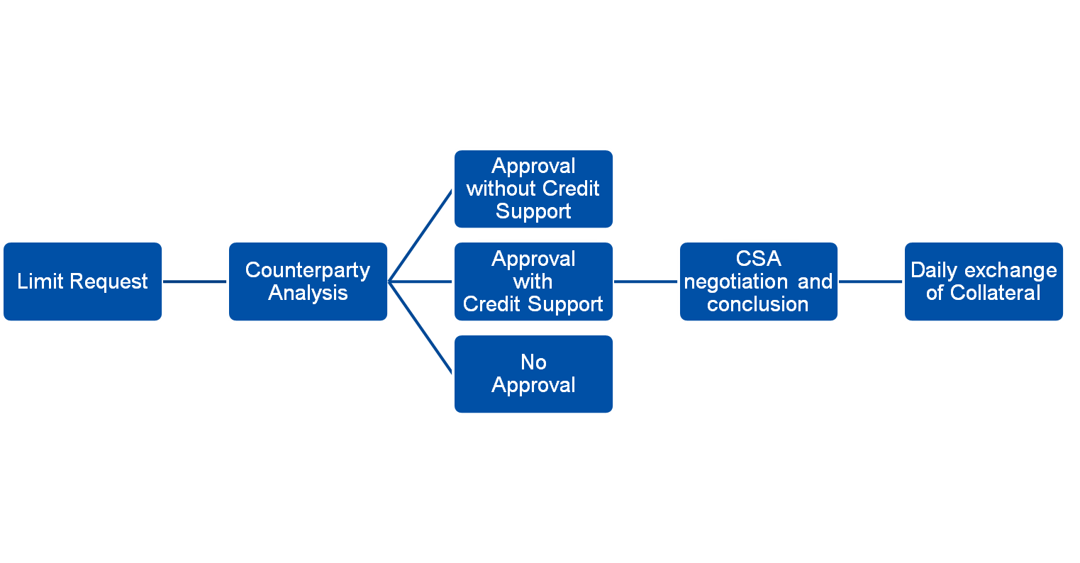
From Limit Request to Collateral Management

Slide 5
Process Overview at RWEST
Exposure Calculation
Margin Calls sent out
Collateral Payment
Dispute Resolution
Interest Payments
VD (*)
VD + 1
Max. VD + 3
Within the first 5 BD (**) of the next month
(*) VD: Valuation Date
(**) BD: Business Day

Slide 6
Exposure Definition and Calculation - Example
Exposure = MTM (+ SE)
MTM = Replacement Risk
SE = Unsettled Deliveries (invoiced or not)
Example:
  Buy of 50 MW German Base Load (OTC Forward)
  Cal12 – Total volume: 439,200 MWh (50 MW x 8784 hrs)
  Trade Date: 01/11/2011
  Traded price: 43 €

Slide 7
Exposure Definition and Calculation - Example
  Buy of 50 MW German Base Load (OTC Forward)
German Base Curve
MTM = Volume x (German Base Curve – Traded Price)
Positive Exposure
Negative Exposure
Nov11
Dec11
Jan12
Feb12
Mar12
SE = Volume x Traded Price
Settlement on 20 calendar day after delivery month
Positive Exposure
Jan12
Feb12
Mar12
Apr12
Negative Exposure
Delivery start point
Jan12 Deliveries
Settlement
Feb12 Deliveries
Settlement

Slide 8
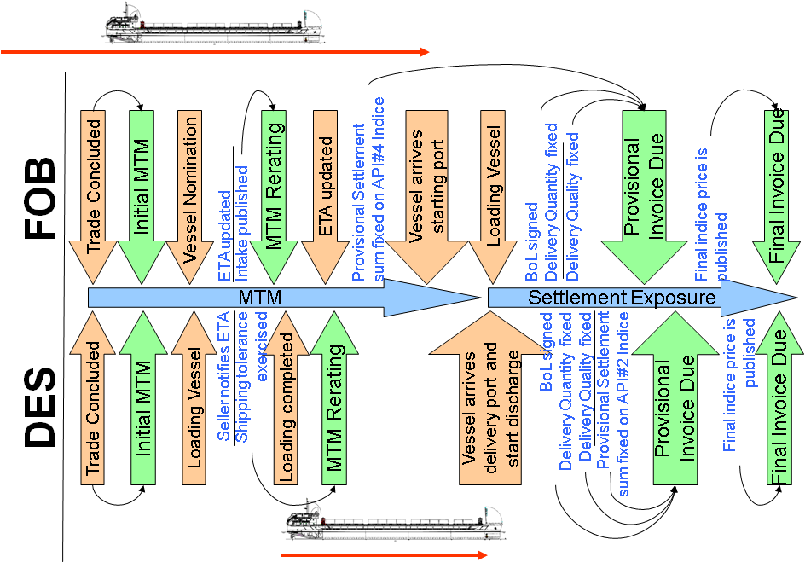
Example related to complex products: Coal Physical

Slide 9
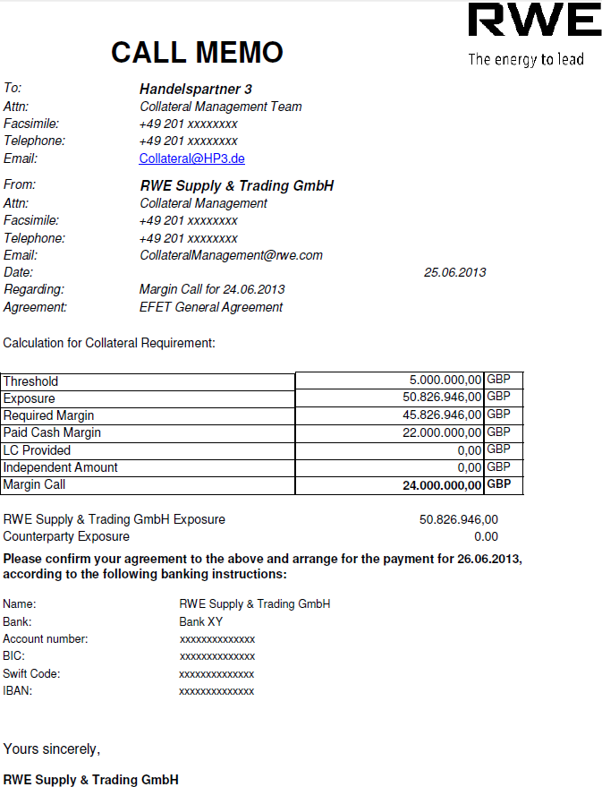
Margin Call Example
General Contract Terms
Involved Parties
Contact Information
Underlying Agreement
Valuation Day
Calculation Parameters
Exposure
Threshold
Collateral Balance (Cash, L/C)
Independent Amount
Margin Call
Payment Information
Bank Accounts
Payment Date
Notes:
Hier sehen wir als Beispiel einen von mir vorbereiteten Margin Call (Sie finden diesen noch einmal als Ausdruck)
Hier wurden alle für die Berechnung wichtigen Daten noch einmal aufgelistet
Neben dem Erstellen und versenden solcher Margin Calls bearbeite ich auch solche die vom Handelspartner gesendet wurden:
Ich überprüfe zunächst ob Rahmendaten wie Thresholds, der aktuelle Bestand an Sicherheiten usw. mit unseren Daten übereinstimmen
Anschließend vergleiche ich die Summen des Gesamtrisikos sowie die daraus resultierende Anforderungssumme
Stimmen unsere Zahlen überein, so bestätige ich dem Handelspartner, dass wir zusätzliche Sicherheiten hinterlegen bzw überschüssige Sicherheiten zurückzahlen werden

Slide 10
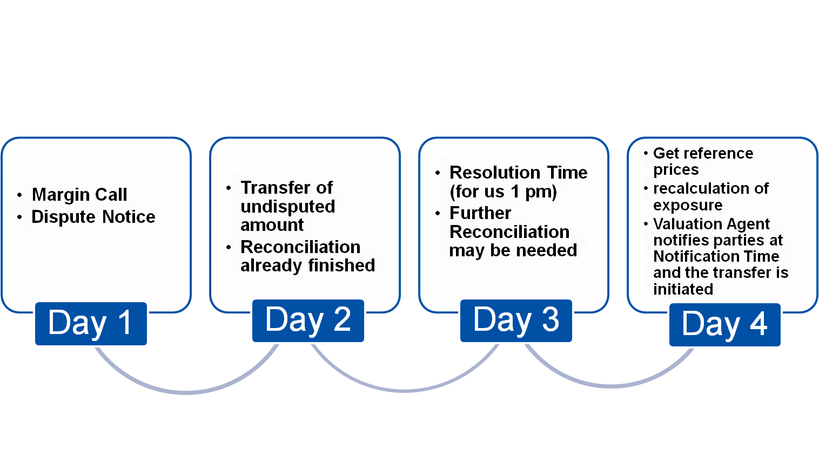
Dispute Resolution
Upcoming regulations on OTC Derivatives will make it necessary to use reconciliation tools for dispute resolution
Timelines need to be taken more seriously than currently done
Standard CSAs as a common market understanding may help (ISDA Working Group)

Slide 11
Exposure Definition and Calculation - Example
Exposure
Receive
Collateral
Receive
Add. Collateral
RWE
Positive Exposure
Return
Collateral
5m €
Dec07
Jan08
Mar08
0 €
Nov07
Feb08
- 5m €
Return
Collateral
Negative
Exposure
CP
Pay
Collateral

Slide 12
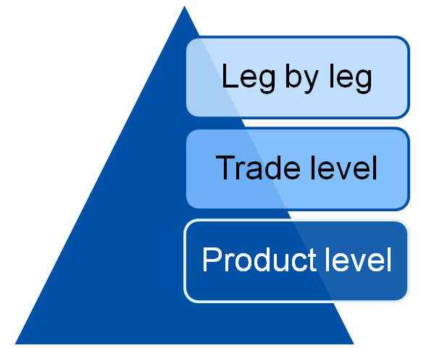
Dispute Resolution
Identify and resolve
Difference in the CSA details (15 min)
Collateral balance, MTA, rounding amount, threshold, independent amount
Difference in the trade details (1 to x days)
Allocation to counterparts, contracts, products and volume
Difference in the settlement exposure (1 to 3 days)
Depends on the nature of the commodity
Difference in the valuation (x days)
Independent broker quotes / reference prices

Slide 13
Dispute Resolution
Intrinsic risk related to collateral
Settlement exposure on complex physical products
Missing definition in CSA and specific technology required to follow-up on Oil and Coal logistics
  EFET Collateral Working Group published document for coal physical settlement exposure for FOB & DES
Operational Risk
Trade or curves setup issues without any regular portfolio reconciliation with counterparts
Manual margining process
Manual and time consuming dispute resolution
  Trade reconciliation tools to be implemented
Cash Risk
Delay in information receipt on late payments (collateral or settlement)
No netted cash flows

Slide 14
Future requirements and success factors
EU Regulations / Dodd Frank (Portfolio reconciliations)
Regular proactive reconciliations
Key factor to resolve disputes within the legal timeframe
Participation in existing working groups to agree on common market understanding
Handling of Independent amounts (initial margin) to be implemented
Necessity of significant IT investments
  Not clear yet whether or how sanctioning will take place
Improvement in cash disposition
Netting of commodity settlement vs. daily margin call
  Not feasible yet because of too short payment deadlines
Netting of commodity settlement vs. collateral balance
  Reduces cash flows and avoids 2 days of risk between settlement due date and collateral return date
  Implies a review of the definition of the exposure (CSA)
  High credit risk if there is not enough buffer in the collateral balance (volatility risk)

Slide 15
Process Overview at RWEST
Success factors
Reporting (internal)
Late Payment Report: to ensure all open settlement risks are covered
Accounting Report: to instruct all Collateral payments and for the financial disposition
Collateral Report: to provide Credit with an overview of all exposures
Dispute Reports: to inform Credit about differences and resolutions
Exchange information with other market participants (external)
Commodity working groups which cooperate and therefore ensure to be complementary and not in competition
To facilitate negotiation of Standard Credit Support Annexes (CSA)
To facilitate the portfolio reconciliation due to standard designs of portfolios

Slide 16
Market Regulations Summary
Financial markets have been subject to regulation over many years (i.e. FSA and BAFIN). However the recent financial crisis, caused by the over-exposure and excessive risk appetite of financial institutions, has resulted in regulators around the world looking to strengthen again the regulatory environment
The major goals of regulation are:
  transparency, ensuring that institutions’ financial affairs are publicly known by requiring regular reporting; and
  making sure that institutions have sufficient assets to meet their contractual obligations, through capital requirements and leverage limits
Import is to understand
  The classification of counterparties as Financial or Non-Financial Counterparty (NFC)
  The obligations EMIR, REMIT and Dodd Frank are enforcing and the transactions in scope
  The impact of obligations that will specifically effect your organisation

Slide 17
EMIR Obligations and to whom they apply
FCs NFC+s NFCs
Clearing Obligation
Financial counterparts (FCs) and Non-Financial Counterparts exceeding the CT (NFC+) must clear OTC derivatives contracts through a registered CCP
Transaction Reporting Obligation
FCs and NFCs must report all their derivatives (OTC and exchange traded derivative transactions) to registered/recognised Trade Repositories (TRs) or to The European Securities and Markets Authority (ESMA) directly
Risk mitigation Obligations for un-cleared OTC derivatives
Timely Confirmations: FCs and NFCs must confirm transactions by set deadlines (and FCs must have procedures for monthly reporting of unconfirmed transactions)
Portfolio reconciliation/compression: FCs and NFCs must agree processes for regular portfolio reconciliation with counterparties and have processes to address portfolio compression opportunities
Dispute resolution: FCs and NFCs must agree the procedures for identification, recording, monitoring and resolution of disputes (and FCs must report on unresolved disputes)
Mark-to-market/model: FCs and NFC+s must carry out daily mark-to-market or, where market conditions prevent this, mark-to-model
Exchange of Collateral: FCs and NFC+s must have procedures for the exchange of collateral
Capital: FCs must have appropriate capital for non-collateralised risks
Clearing members: clearing members of CCPs are subject to certain segregation, disclosure and other obligations
✓
✓
✓
✓
✓
✓
✓
✓
✓
✓
✓
✓
✓
✓
✓
✓
✓
✓
✓
✓
✓
✓
*NFCs must immediately notify the competent authority if their positions in OTC derivatives (excluding hedging positions) exceed the specified clearing threshold. The threshold will be reviewed quarterly and be carried out by the Clearing & Collateral Team (Dirk Daveluy)

Slide 18
EMIR Obligations and to whom they apply
FCs NFC+s NFCs
Clearing Obligation
Financial counterparts (FCs) and Non-Financial Counterparts exceeding the CT (NFC+) must clear OTC derivatives contracts through a registered CCP
Transaction Reporting Obligation
FCs and NFCs must report all their derivatives (OTC and exchange traded derivative transactions) to registered/recognised Trade Repositories (TRs) or to The European Securities and Markets Authority (ESMA) directly
Risk mitigation Obligations for un-cleared OTC derivatives
Timely Confirmations: FCs and NFCs must confirm transactions by set deadlines (and FCs must have procedures for monthly reporting of unconfirmed transactions)
Portfolio reconciliation/compression: FCs and NFCs must agree processes for regular portfolio reconciliation with counterparties and have processes to address portfolio compression opportunities
Dispute resolution: FCs and NFCs must agree the procedures for identification, recording, monitoring and resolution of disputes (and FCs must report on unresolved disputes)
Mark-to-market/model: FCs and NFC+s must carry out daily mark-to-market or, where market conditions prevent this, mark-to-model
Exchange of Collateral: FCs and NFC+s must have procedures for the exchange of collateral
Capital: FCs must have appropriate capital for non-collateralised risks
Clearing members: clearing members of CCPs are subject to certain segregation, disclosure and other obligations
✓
✓
✓
✓
✓
✓
✓
✓
✓
✓
✓
✓
✓
✓
✓
✓
✓
✓
✓
✓
✓
✓
*NFCs must immediately notify the competent authority if their positions in OTC derivatives (excluding hedging positions) exceed the specified clearing threshold. The threshold will be reviewed quarterly and be carried out by the Clearing & Collateral Team (Dirk Daveluy)

Slide 19
Thank you for your attention
Questions & Answers

